Slide 1

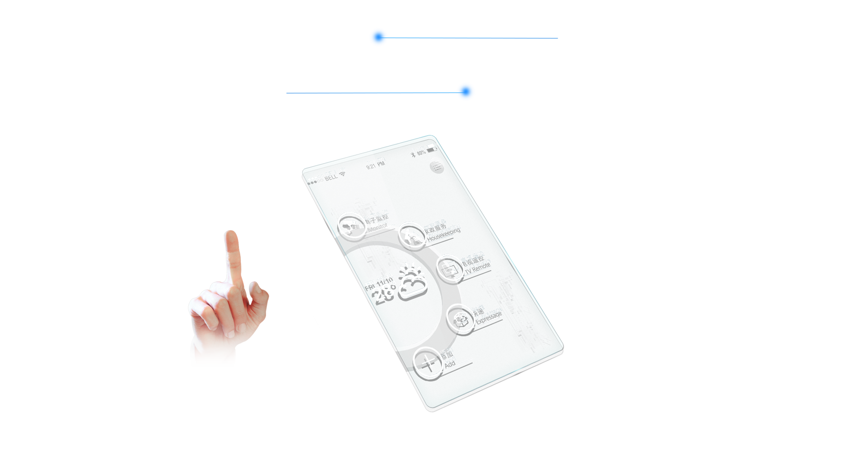
A Statistical Analysis of the Growing Adoption of AR/VR in Real World
Ankit Alex Minz^{[1]}, Dibya Bharat Khatua^{[2]}, Ruchi Sawhney^{[3]}
[1 & 2] Scholar, Department of CS/IT, Bosco Technical Training Society, Don Bosco Technical School, Okhla Road, New Delhi-110025
[3] Assistant Professor, Department of CS/IT, Bosco Technical Training Society, Don Bosco Technical School, Okhla Road, New Delhi-110025

Slide 2
Introduction
Augmented Reality
Increasing Usage
AR overlays digital information onto the real world
It utilizes human senses and combines computer-generated data with reality.
Its integration of senses has led it to being used in various fields like marketing, shopping etc.
Global AR/VR headset shipments projected to reach 43.5 million by 2025.
The Annual Growth rate of AR/VR 2024-2028 is projected at 10.77%
Industry Adoption
Virtual Reality
AR & VR has seen widespread adoption across various industries from gaming to healthcare.
These adoptions range from providing immersive experiences for customers to practicing surgery in hospitals.
Examples include OSSOVR, PokemonGO, Tilt Brush, Enscape and Toyota’s TeenDrive 365..
VR creates simulated environments for immersive experiences.
It immerses users in computer-generated environments.
It uses interactive devices like goggles, headsets, gloves or body suits..
Enhance Skill Training
AR/VR technologies revolutionize training with realistic simulations.
They enhance experiential learning for emergency preparedness, military training, healthcare, etc.
They are even being used in pólice training.

Slide 3
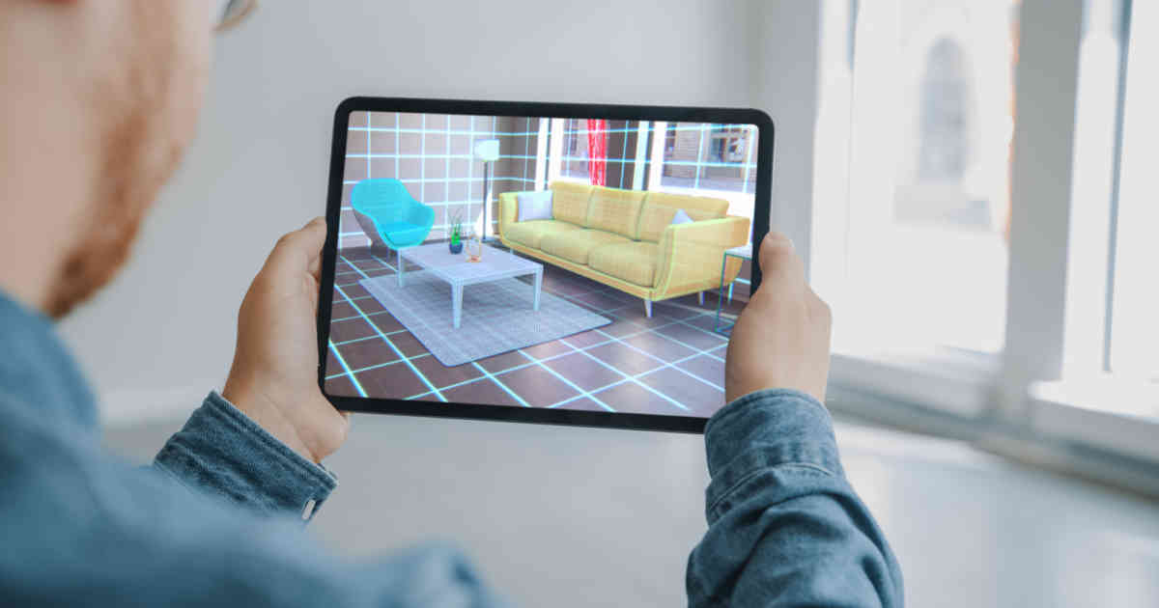
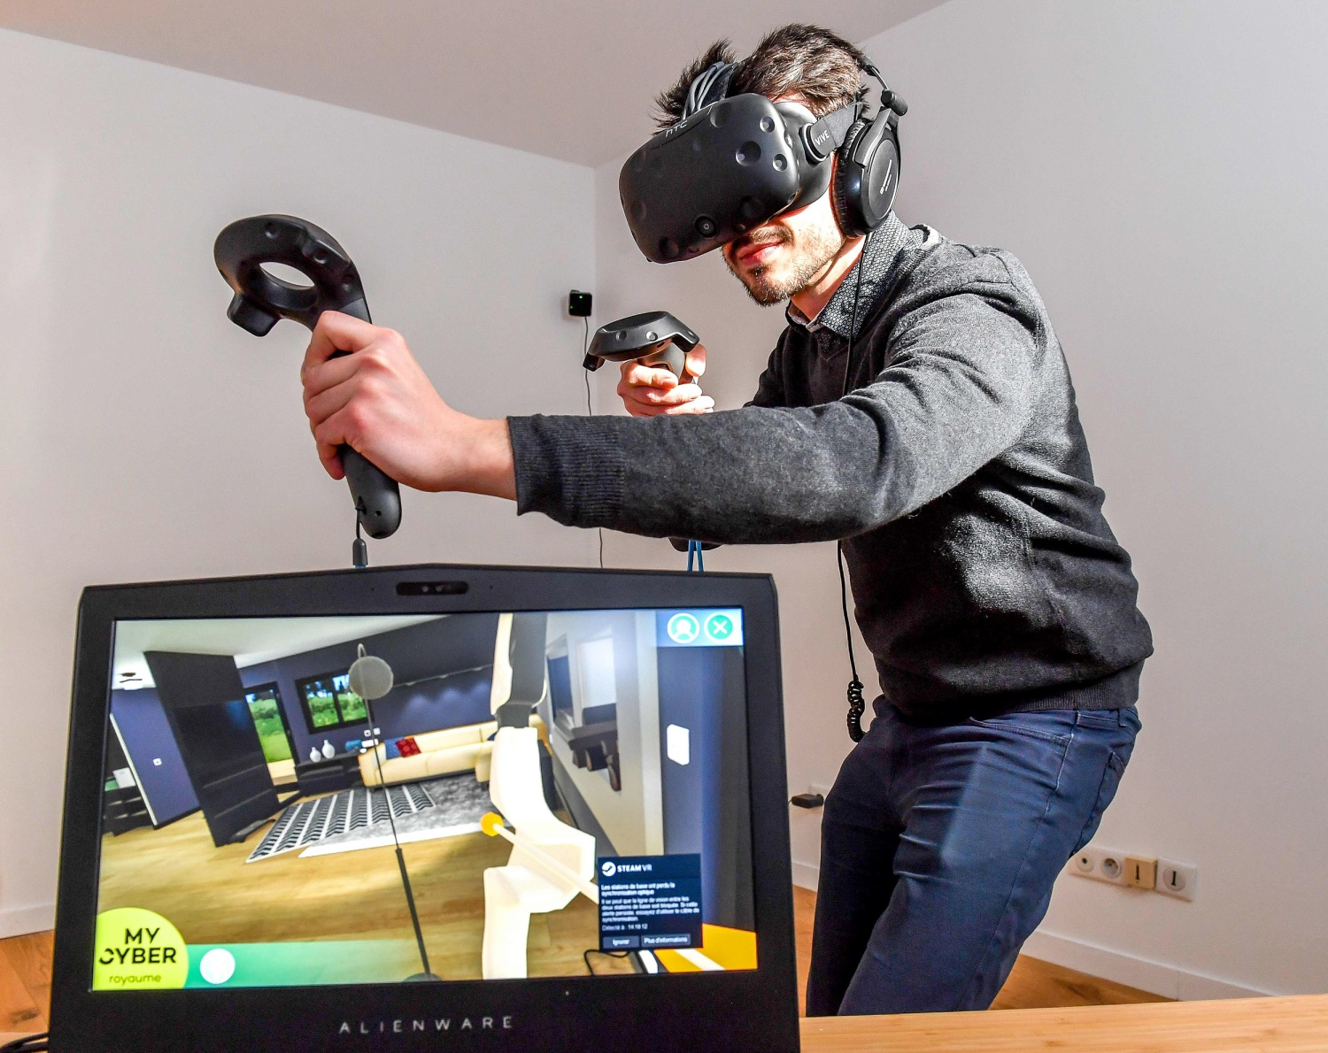
Augmented Reality
Virtual Reality

Slide 4
Examples and Related Work
Reference | Subject | Method | Findings
Abdullah M. Al-Ansi | AR and VR development in Education | Analyzing | Adoption of AR and VR in education recent years
Dr A Udaya Shankar | Impact of AR and VR in Education | Literature Review | Improvement in teaching and learning experience
Patrice Labedan | VR in pilot training | Case Study | Cardiac activities during training
Zain Hussain | Use of AR and VR for improving knowledge and skills in medical students | Randomized Trials and Pre-test, Post-test | Effectiveness of AR/VR devices for teaching medical students
Min-Chai Hsieh | AR for primary marine wildlife education | ADDIE model with Pre and Post test | Using augmented reality to enhance learning experience of children for marine wildlife education
İbrahim Yaşar Kazu | Engagement of AR and VR in higher studies | Data Analysis | VR's adaptability and potential for personalized learning experiences contributing to more efficient and effective learning
Jing Zhang | Trends in the Use of Augmented Reality, Virtual Reality, and Mixed Reality in Surgical Research | Global Bibliometric and Visualized Analysis | use of augmented reality (AR), virtual reality (VR), and mixed reality (MR) in surgical research increased globally

Slide 5
Hypothesis 1
The Usage and Implementation of AR/VR in various fields are still increasing.
Hypothesis
Hypothesis 2
Developing implementations will have a majorly positive impact on the AR/VR technology field.
Hypothesis 3
Common use commercial implementation of AR/VR are becoming increasingly popular.

Slide 6
Hypothesis 1 : Information Study
Fields | Statistics
Education | VR in education valued at USD 28.85B in 2024, projected to reach USD 67.02B by 2029. 1 in 5 adults in US experience AR and VR.
Healthcare | AR/VR experienced in healthcare valued at USD 658.2M in 2020, expected to grow to USD 8.5B by 2028 with a CAGR of 18.8% from 2023 to 2030.
Gaming | virtual reality (VR) in gaming market size was valued at USD 7.92 billion in 2021 and is projected to reach USD 53.44 billion in 2028, at a CAGR of 31.4% during 2021-2028
Automobile | the global virtual reality in automotive market size was valued at USD 759.3 million in 2019 and is projected to reach USD 14,727.9 million by 2027, exhibiting a CAGR of 45.1% during the forecast period
Engineering | The engineering and construction sectors’ VR and AR market is projected to reach USD 4.76 billion by 2025.
Military | The spending on VR is approximately $6.4 billion in the US, $5.1 billion in the Asia Pacific region, and $3 billion in Europe, Middle East, and Africa combined
Manufacturing | The global augmented reality & virtual reality in manufacturing market size was valued at USD 8.01 billion in 2022 and is expected to grow at a compound annual growth rate (CAGR) of 28.3% from 2023 to 2030.
Entertainment | VR/AR usage rates: social media (47%), followed by videogames (40%), live streaming (32%), film and entertainment (31%), advertising (28%), and music (28%).

Slide 7
Graph & Charts

Slide 8
Hypothesis 2
Spatial Computing
Immersive Commerce
Emotion Recognition
Haptic Feedback
AR and VR technologies are continuously reshaping multiple sectors, like education, healthcare, gaming, automotive, engineering, military, manufacturing and entertainment.
Throughout all fields it can be said that immersiveness is the common attraction, as the AR/VR technologies allow the simulation of various things with good accuracy, allowing people to gain experience without experiencing those situations in reality.

Slide 9
AR/VR Fields
Fields | Use/ Benefits
Healthcare | Training, diagnostics, surgery, and fitness. Foster a deeper understanding of complex concepts, ignite student curiosity, and promote collaborative learning.
Gaming | Immersive Interaction, smell, touch, physics, movements.
Automotive | Design, production, sales and marketing
Engineering | Architecture, Engineering and Construction. Enhance comprehension of intricate processes
Military | Equipment training, flight training, weapons training etc. Revolutionize the way armed forces personnel access information, plan mission strategy, and conduct critical operations.
Manufacturing | Modernize and streamline processes, eliminate costly errors and reduce downtime
Entertainment | Enhance product visualization and the customer experience.

Slide 10
Hypothesis 3
 | Apple ARkit | Google ARcore | Meta quest | HTC Vive | Sony Playstation VR
Launched date | 5 June 2017 | 1 March 2018 | 21 May 2019 | 5 April 2016 | 13 October 2016
Developed by | Apple Inc. | Google | Meta platforms | HTC corporation | Sony Group
Based on | AR (augmented reality) | AR (augmented reality) | VR (Virtual Reality) | VR (Virtual Reality) | VR(Virtual Reality)
Features | Device motion tracking World tracking Scene understanding display conveniences | Motion tracking. Environmental understanding. Depth understanding. Light estimation. User interaction. Oriented points. Anchors and trackable. Augmented Images. | Boundary, Pass-through and Spatial Anchors Voice commands and voice dictation Display settings Accessibility features | Eye tracking Motion Tracking Audio Strap Wireless Adapter Facial Tracker | 5.7 inch OLED panel 1080p resolution Social Video screen enabled 3D audio effect 360 degree head movement

Slide 11
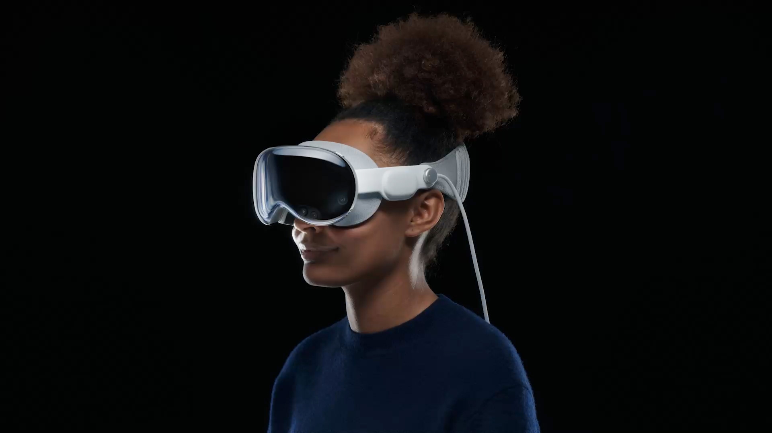
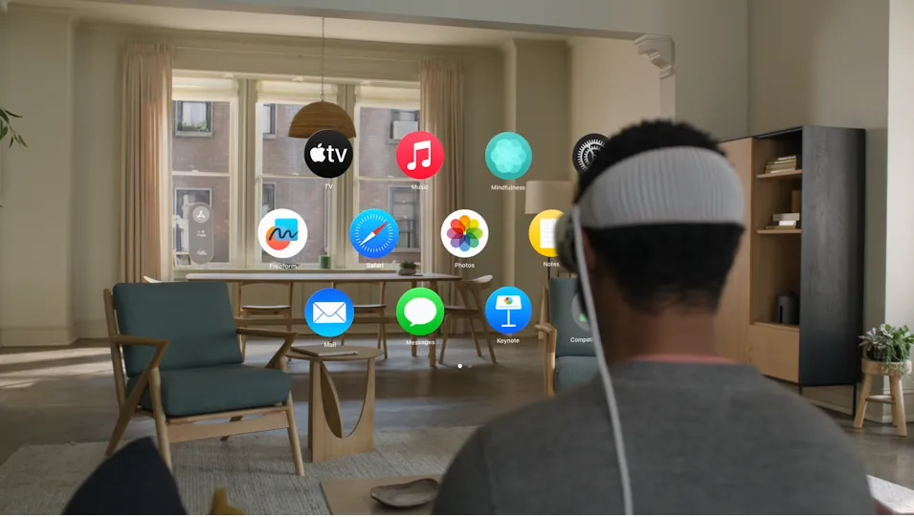
Apple Vison Pro: Current AR/VR Trend
Announced at Apple's Worldwide Developers Conference on June 5, 2023.
Pre-orders began on January 19, 2024, and it became available for purchase on February 2, 2024.
Described as a "spatial computer" blending digital and physical media.
Despite its higher price and shorter battery life, the Vision Pro has exceeded sales expectations.
Initial sales projections of 150,000 to 200,000 units surpassed, with sales exceeding 200,000 units.
Return percentages dropped to 1%, indicating high customer satisfaction.

Slide 12
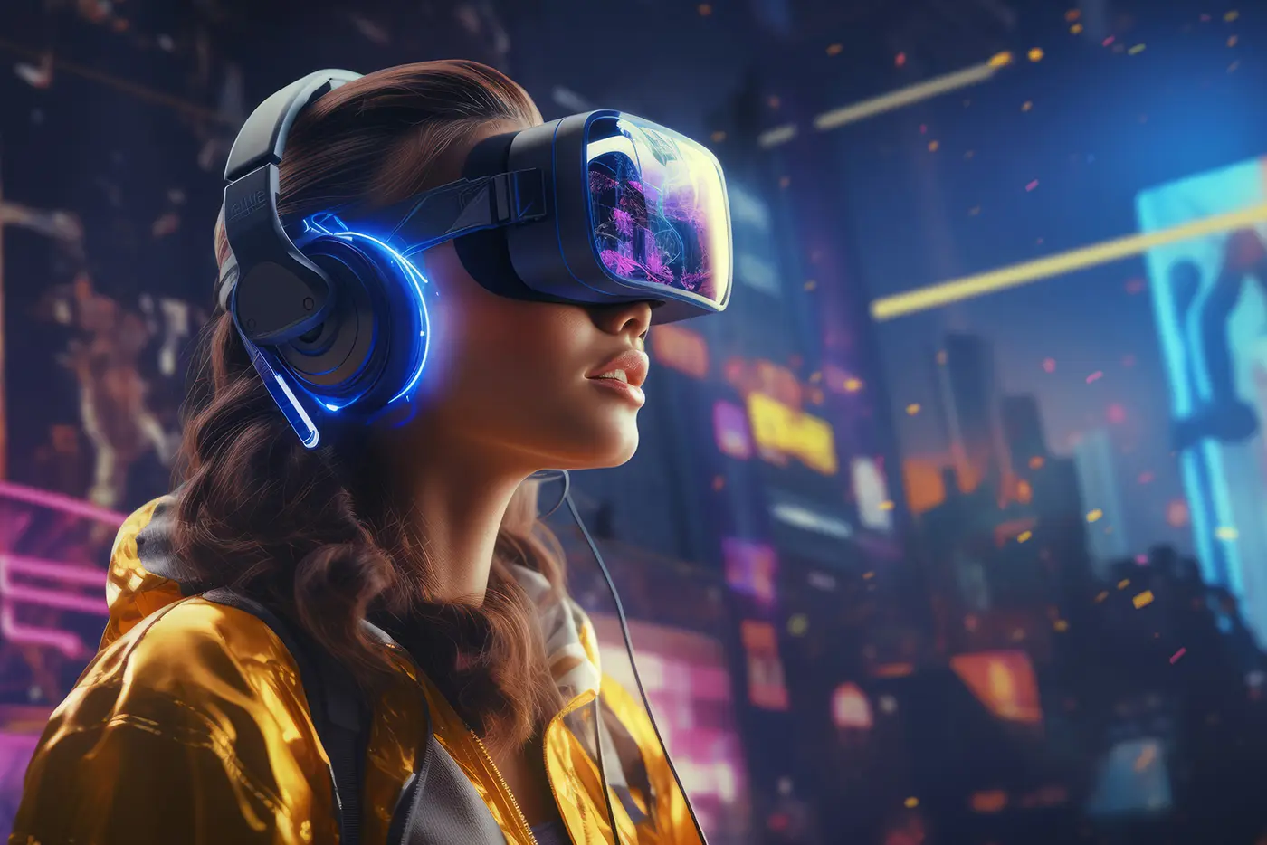
Conclusion
The usage and implementation of AR/VR are projected to continue increasing, driving growth in sales and market size as more implementations are introduced. This expansion is anticipated to have positive impacts on users, companies, and the AR/VR field overall. With advancements in performance from these implementations, we can expect to see more convenient and well-implemented devices entering the commercial AR/VR products market, poised for success. It's important to note that these hypotheses converge and mutually influence each other, highlighting the interconnected nature of the AR/VR ecosystem.

Slide 13
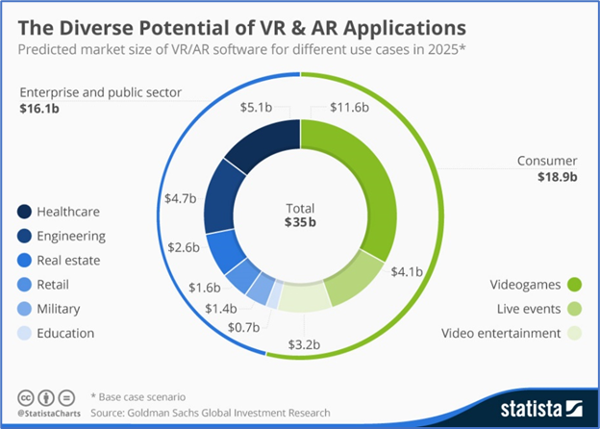
Future Scope

Slide 14

THANK YOU

